Slide 1


Bangladesh Army University of Science & Technology
Department of Computer Science & Engineering
Database management systems sessional
Course Code: CSE 2206
PROJECT NAME : Online Blood Bank Management
Group No : 6
Group Member
Project Supervisor
Hasan Muhammad Kafi
Assistant Professor
NAME : Tabassum Aroni
ID :220101015
NAME : Nusrin Toma
ID :2201010116
NAME : Moumita Sarkar mou
ID : 2201010117
NAME :Fahim Foysal
ID :210101026

Slide 2

Table of Contents
01
02
03
04
Introduction
Problem Definition
Objectives
Issues Encounted
08
06
07
Tools & Technology
Conclusion and Limitations
05
Stakeholders
10
09
System Architecture
Database Design
Implementation

Slide 3
01.
Introduction
A Blood Bank Management System is a critical component of healthcare infrastructure that plays a pivotal role in ensuring the availability of safe and compatible blood and blood products for patients in need.
It serves as the bridge between voluntary blood donors and individuals requiring blood transfusions, making it an essential and life-saving part of the medical ecosystem.

Slide 4
02.
Problem Definition
Blood Shortages
Blood Wastage
Lack of Standardization
Inadequate Donor Management
Manual and Paper-Based Systems
Reporting and Compliance

Slide 5
03.Available Application
https://bbms.dghs.gov.bd

Slide 6
04 .Stakeholders
Blood Donors
Blood Wastage
Lack of Standardization
Inadequate Donor Managemen
Data Privacy and Security

Slide 7
05 Issues Encountered
Blood Shortages
Inventory Management
Blood Wastage
Donor Recruitment and Retention
Quality Control
Emergency Response
Technology Adoption
Staff Training
Public Awareness

Slide 8
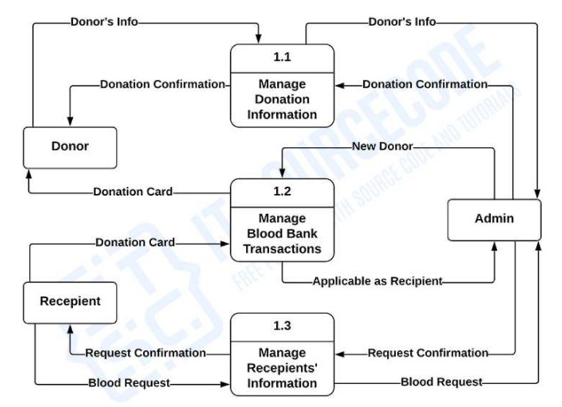
06.System Architecture

Slide 9
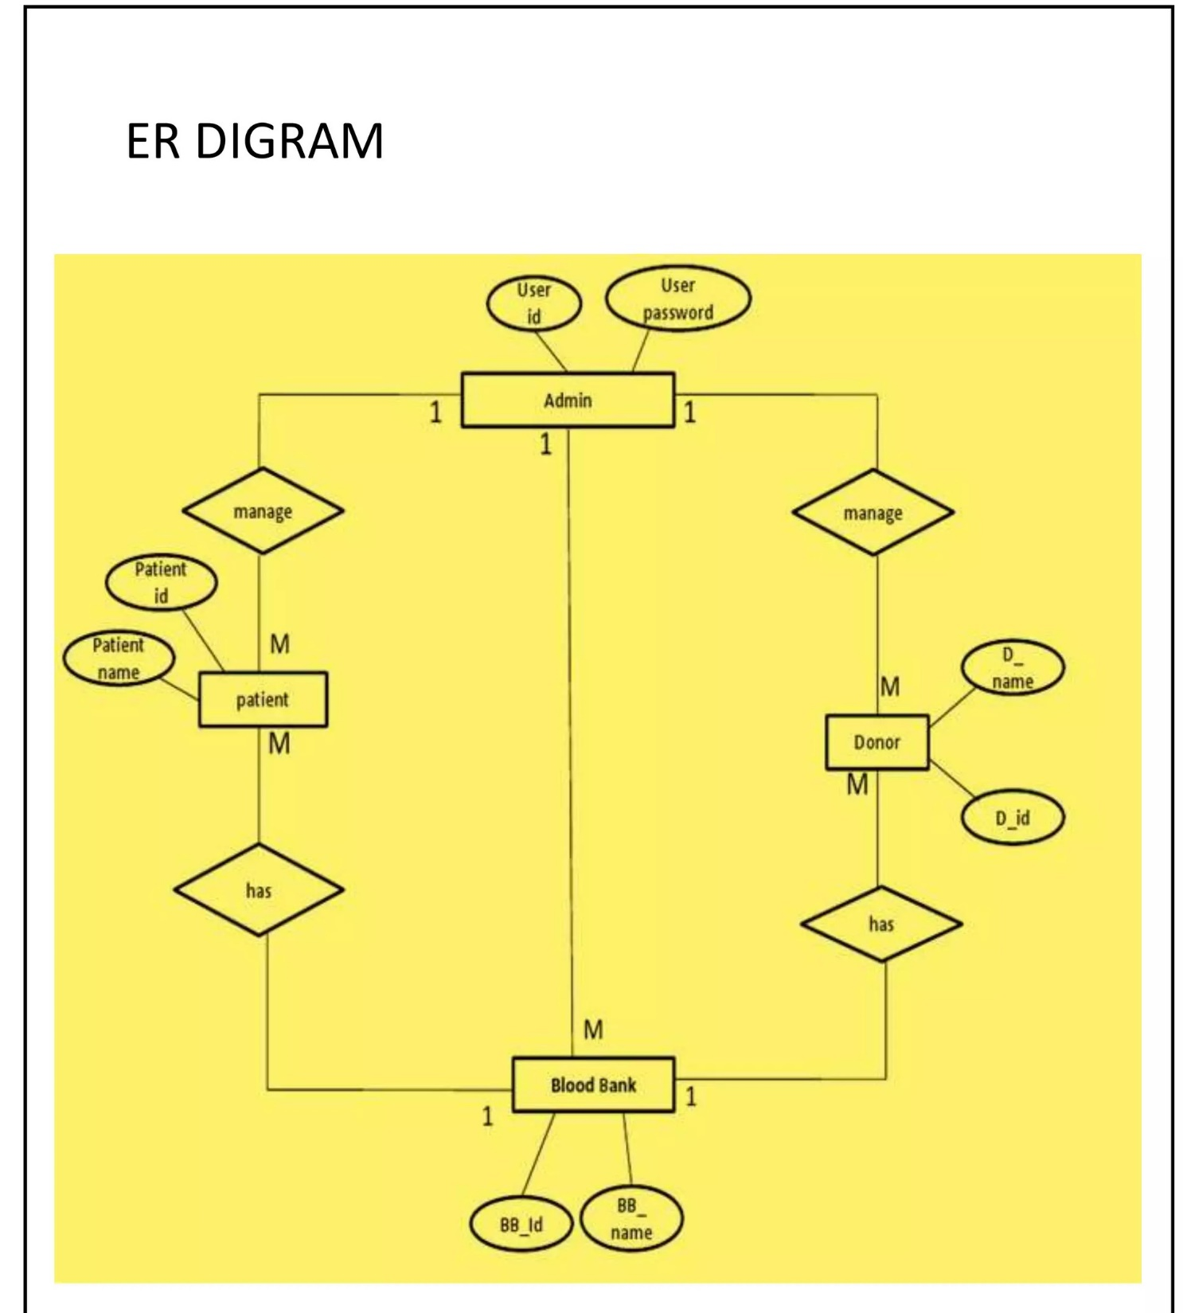
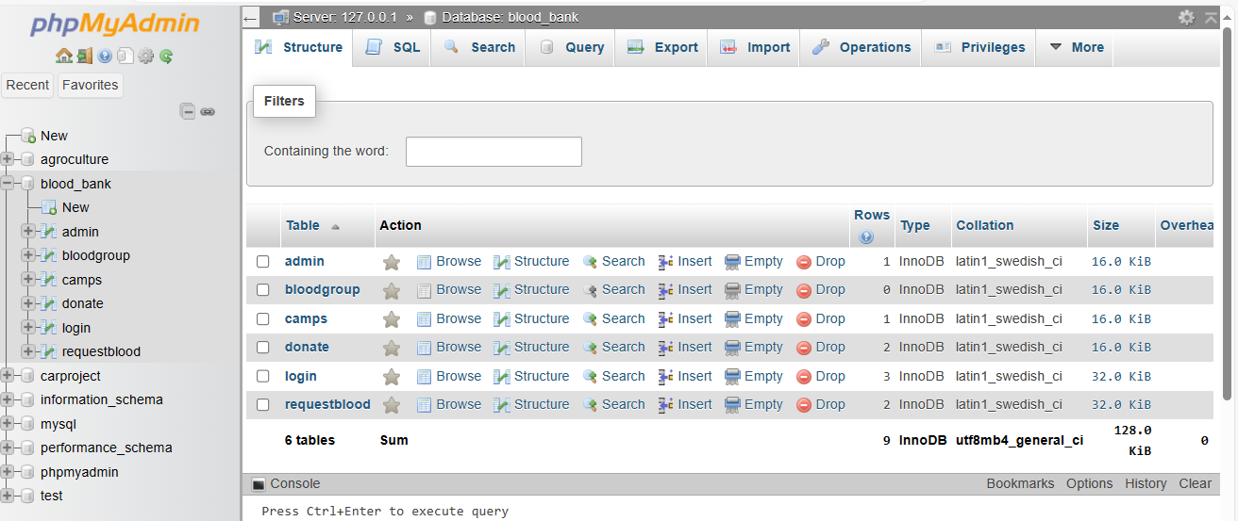
07 Database Design

Slide 10
08. Tools & Technology
A markup language used for creating and structuring web content
HTML
CSS
A styling language used for enhancing the look and feel of web content.
A server-side scripting language used for developing dynamic web pages and applications.
PHP
MySQL
An open-source relational database management system used for storing and retrieving data.

Slide 11
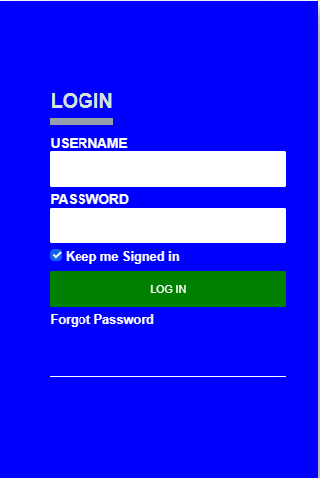
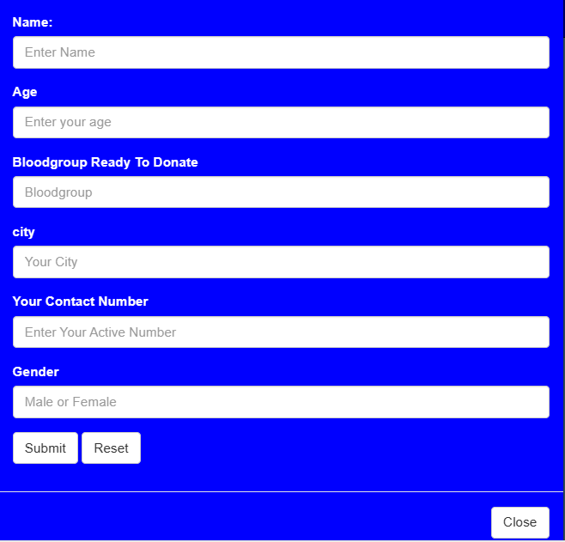
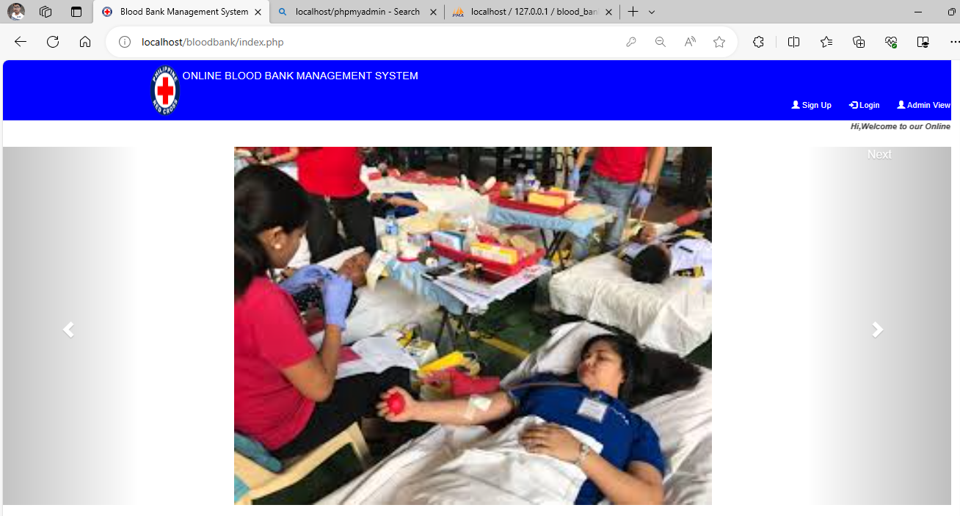
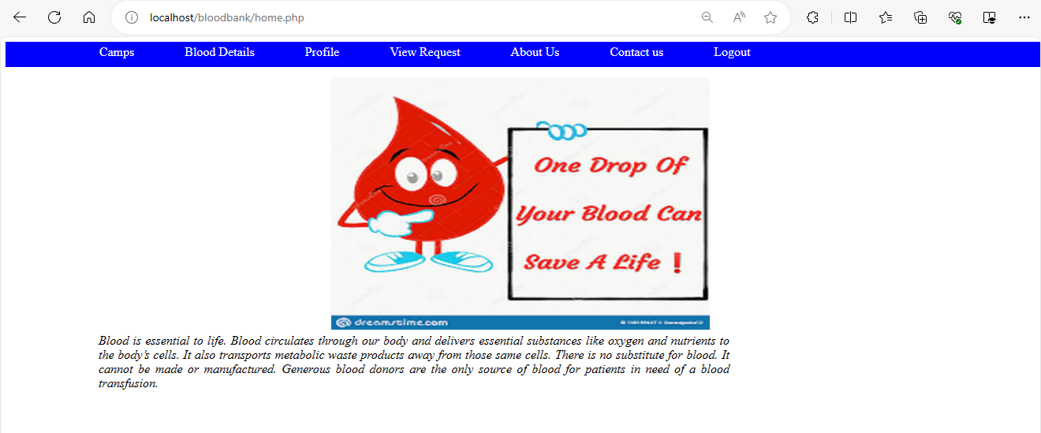
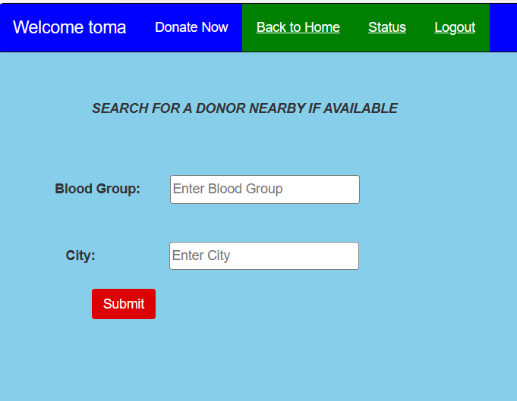
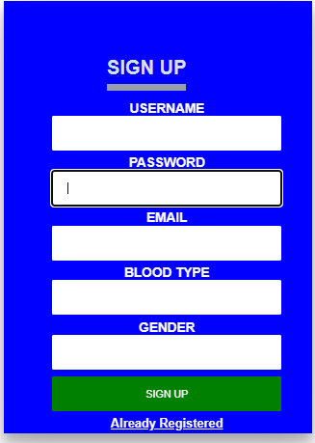
09.Implementation

Slide 12
10.
Conclusion and Limitations
In conclusion, an Online Blood Bank Management System is a vital and efficient solution for the organization, coordination, and automation of blood donation and distribution processes. It streamlines donor recruitment, ensures the safety and quality of blood products, and facilitates quick responses during emergencies. By leveraging technology, such a system can enhance the availability of life-saving blood and strengthen healthcare systems, ultimately improving the quality of patient care and public health.

Slide 13
Reference
ChatGPT3.0
https://www.studocu.com/in/document/veer-narmad-south-gujarat-university/bachelor-of-computing/blood-bank-management-system-dfd-levels-0-1-2/24104649
Google

Slide 14
Thanks Everyone

